Slide 1
Topic: Trigonometry
EQ: How can I apply trigonometry to solve real-life problems?

Slide 2
Topic: Trigonometry EQ: How can I apply trigonometry to solve real-life problems?
Summary:

Slide 3

Topic: Trigonometry EQ: How can I apply trigonometry to solve real-life problems?
Solving Real-Life Problems
Problem : Find the length of h.
B
h
C
15
12
A
D
13

Slide 4
Topic: Trigonometry EQ: How can I apply trigonometry to solve real-life problems?
Problem : Find the length of h.
Answer:
Find length BD first
B
h
C
15
12
A
D
13

Slide 5
Topic: Trigonometry EQ: How can I apply trigonometry to solve real-life problems?
Problem : Find the length of length h.
Now find h
B
h
C
15
12
A
D
13

Slide 6
Topic: Trigonometry EQ: How can I apply trigonometry to solve real-life problems?
Problem : Find the diagonal length of the cuboid AG.
F
G
B
C
7cm
E
H
6cm
A
D
8cm

Slide 7
Topic: Trigonometry EQ: How can I apply trigonometry to solve real-life problems?
Problem : Find the diagonal length of the cuboid AG.
Answer:
Find AH first
F
G
B
C
7cm
E
H
10cm
6cm
A
D
8cm

Slide 8
Topic: Trigonometry EQ: How can I apply trigonometry to solve real-life problems?
Problem : Find the diagonal length of the cuboid AG.
Now find AG
F
G
B
C
7cm
E
H
10cm
6cm
A
D
8cm

Slide 9
Topic: Trigonometry EQ: What are the key trigonometric ratios I need to know?
Homework: Mathspace Task – Trig Ratios
Complete your summary
Summary:

Slide 12


Topic: Trigonometry Review EQ: What are the key trigonometric relationships I need to know?
S^{O}H C^{A}H T^{O}A

Slide 13
Topic: Trigonometry Review EQ: What are the key trigonometric relationships I need to know?
S^{O}H C^{A}H T^{O}A
(4 marks)

Slide 14
Topic: Trigonometry Review EQ: What are the key trigonometric relationships I need to know?
S^{O}H C^{A}H T^{O}A

Slide 15
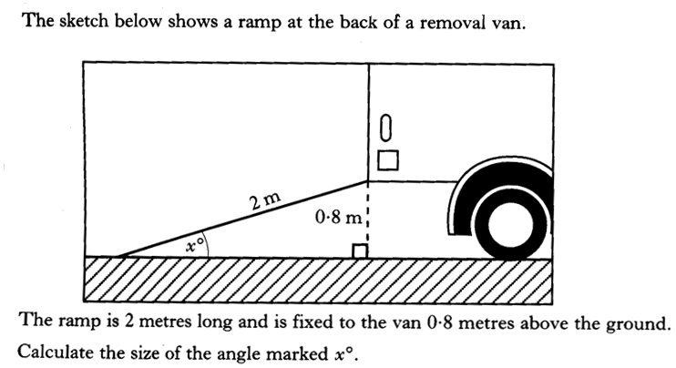
Past Paper Type Questions
Topic: Trigonometry Review EQ: What are the key trigonometric relationships I need to know?
S^{O}H C^{A}H T^{O}A
4 marks

Slide 16
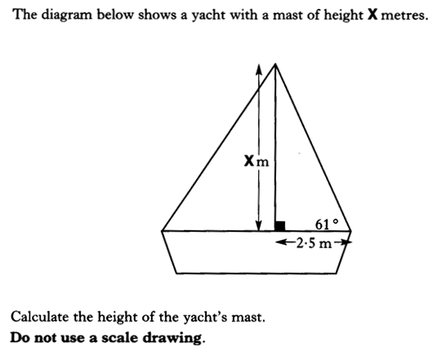
Past Paper Type Questions
Topic: Trigonometry Review EQ: What are the key trigonometric relationships I need to know?
S^{O}H C^{A}H T^{O}A

Slide 17
Past Paper Type Questions
Topic: Trigonometry Review EQ: What are the key trigonometric relationships I need to know?
S^{O}H C^{A}H T^{O}A
(4marks)

Slide 18
Past Paper Type Questions
Topic: Trigonometry Review EQ: What are the key trigonometric relationships I need to know?
S^{O}H C^{A}H T^{O}A

Slide 19
Past Paper Type Questions
Topic: Trigonometry Review EQ: What are the key trigonometric relationships I need to know?
S^{O}H C^{A}H T^{O}A
(4marks)

Slide 20
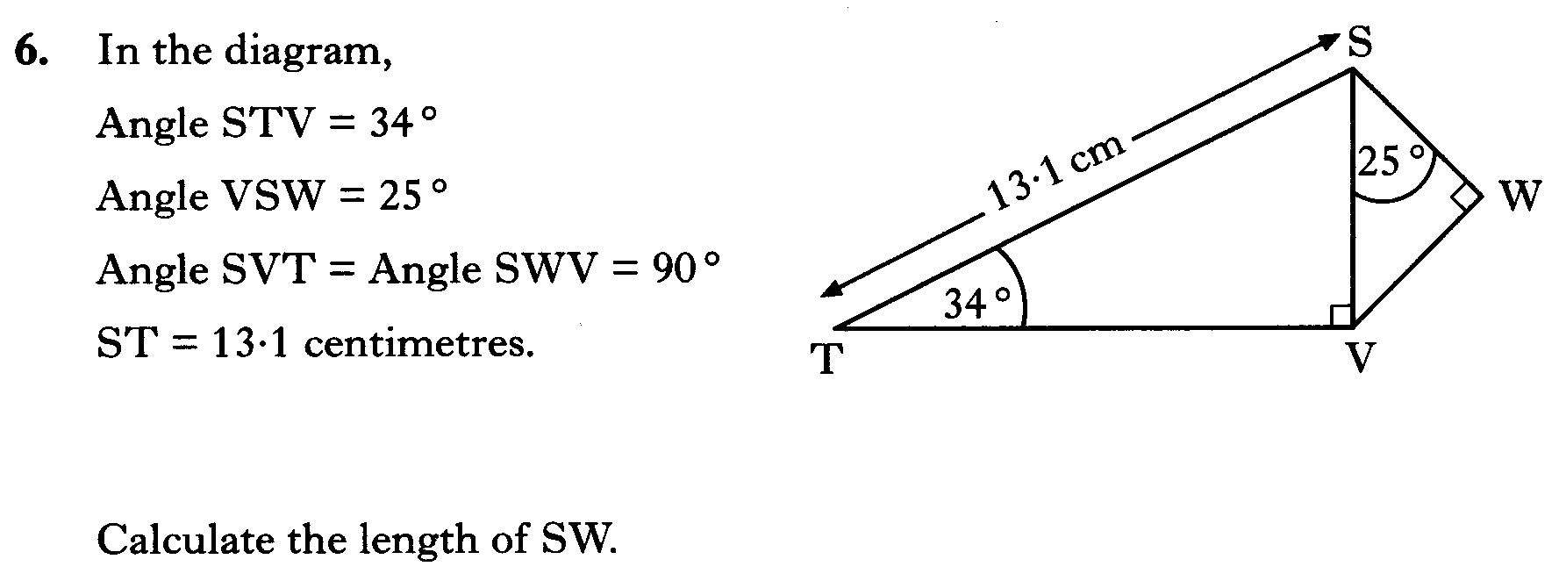
Topic: Trigonometry Review EQ: What are the key trigonometric relationships I need to know?

Slide 21
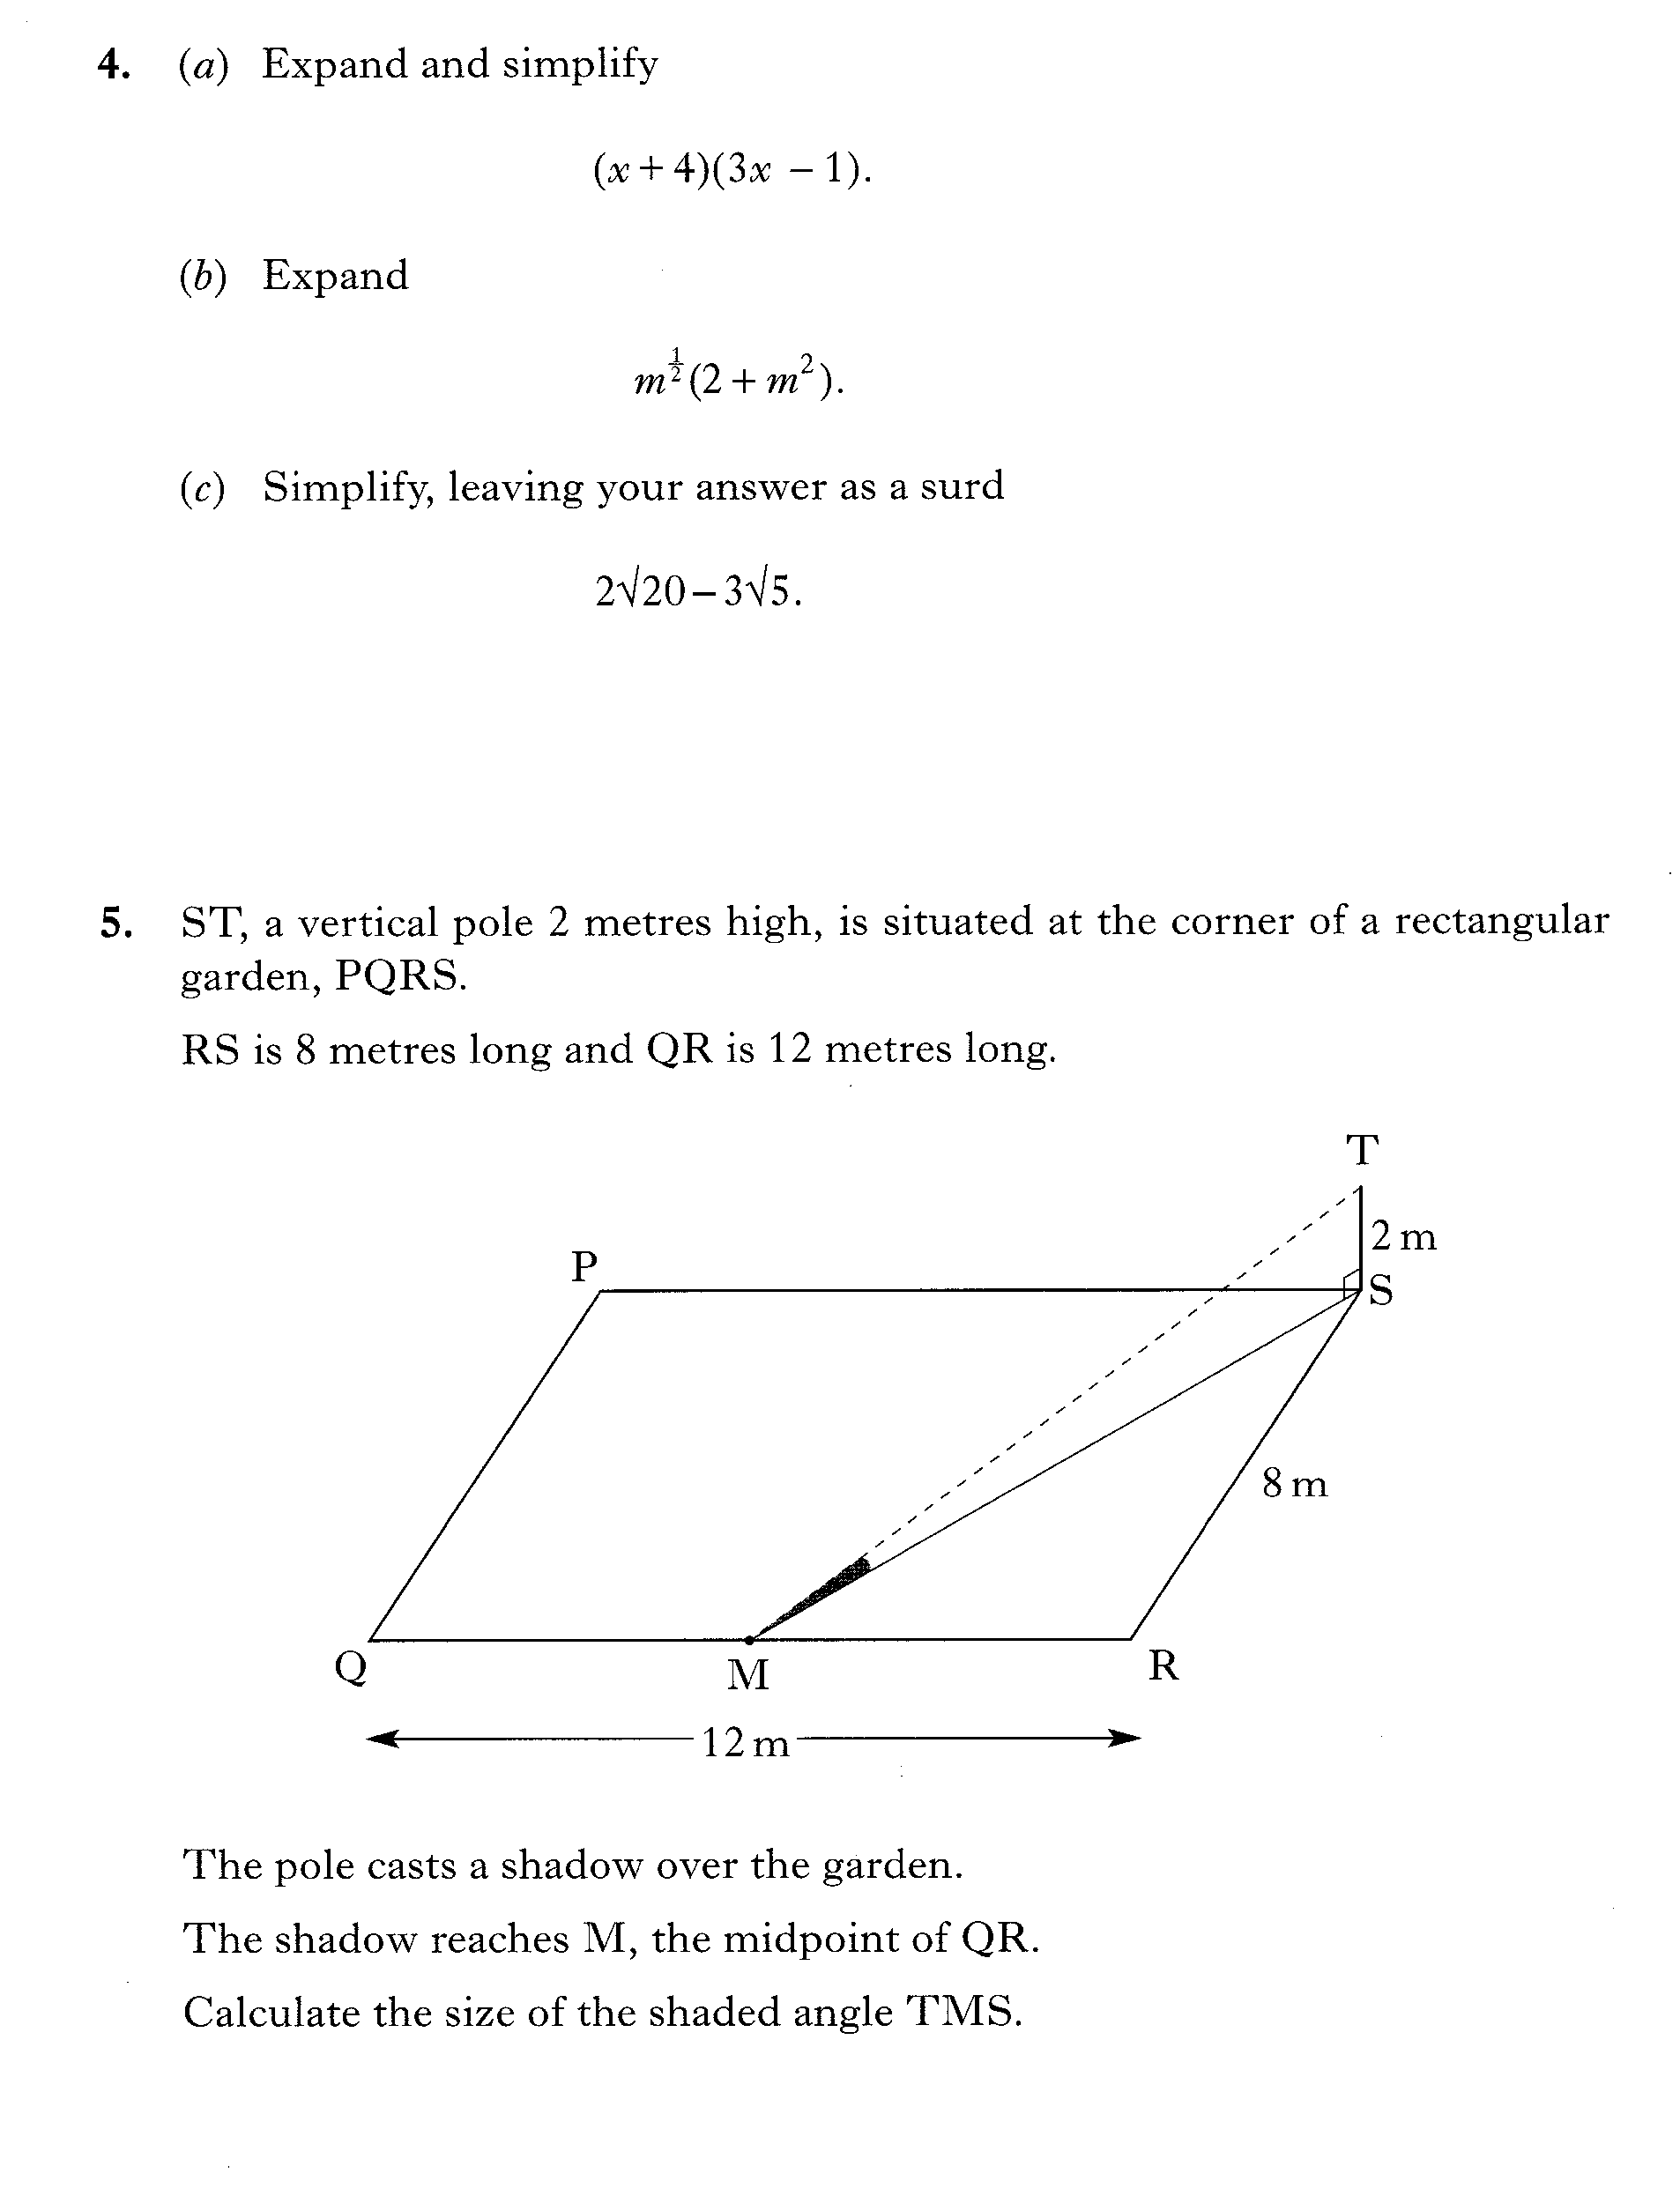
Topic: Trigonometry Review EQ: What are the key trigonometric relationships I need to know?

